Slide 1


ISM 6124 Advanced Systems Analysis & Design
STUDENT HABITATION
Team Members
ABHISHEK MALGA
GURRAM RUPA
LAKSHMI SAI PRASANNA
LOKESH REDDY VAZRALLA
CHAITANYA SAI KOPPARTHI

Slide 2
Selected Process
Designing a third-party website where customer will be able to lease a house and complete the payment gateway securely.
Customer will be able to sign the lease once they complete the lease payment with 48Hrs of application signup.
Features:
Secure and trusted payment gateway
Only trusted properties are listed.
24/7 Customer support availability

Slide 3
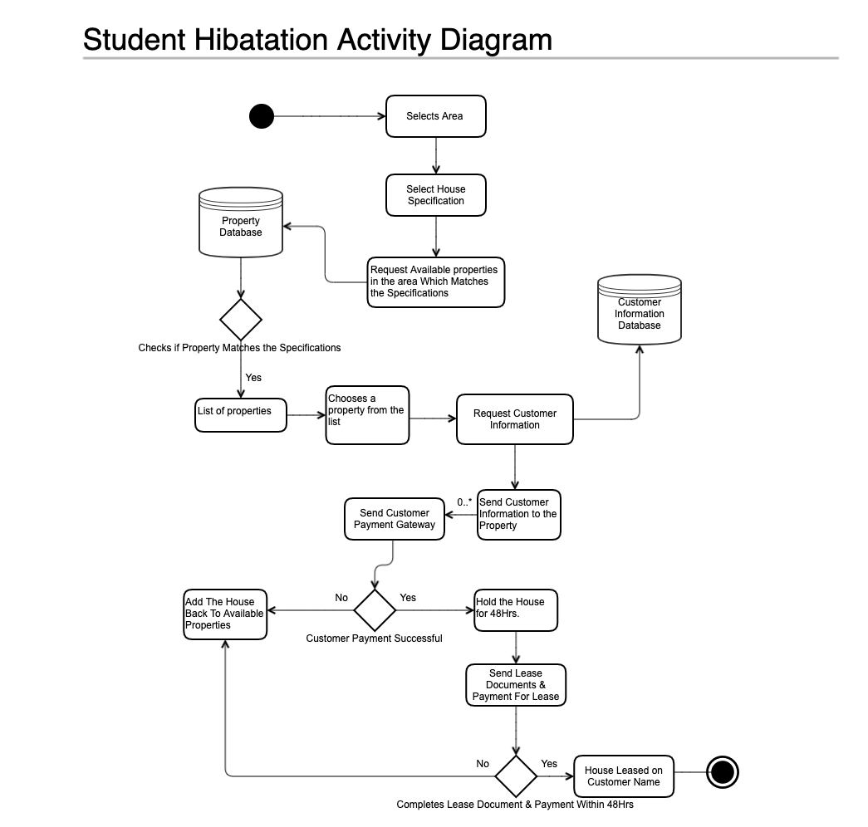
Design Solution

Slide 4
Analysis Performed
According to a survey in 2020 - 2021 an estimated 43.1% of renters have encountered a listing they suspected was fraudulent. And 5.2 million U.S. renters have lost money from rental fraud.
Younger renters are more likely to experience rental fraud, with 9.1% of 18 to 29-year-old renters having lost money on a rental scam.
Among renters who have lost money in rental scams, one in three have lost over $1,000, likely after paying a security deposit or rent on a fraudulent property.

Slide 5
Activities In The Project
Idea Proposal: The business idea that was proposed is the “Student Housing” where we as a third party offer guarantee housing services to the students.
Requirements: The proposal requires a genuine website that assures housing for the applicants.
Planning: On whole, the implementation might take 2 months, if the 3M’s(Men, Material and Money) are made sure.
Design: The system design, interface design and the data processing are the three crucial parts that the phase need to be focused on.
Execution/Implementation: The website that is created will be integrated with the clients and will be tested to bring the trusted housing service into existence.

Slide 6
Stages of Development
Plan Details: Based on planning details, we need technically well-approved men, resources(infrastructure) and money for the progressive phase of building which can help us to deliver the output on the planned date.
Allocation: Once the planning is all done, the next step is to decide the scheduling - who will do time and by when the subtasks and tasks need to be completed.
Kickoff: The project needs to be set into motion and tracked for every cycle to make sure that work, timeline and resources are balanced and followed accordingly.
Testing: The output of the previous phase is tested for the quality assurance.
Monitoring/Review: Now, the final report is submitted to the clients for the feedback on how the work was managed and if any further concerns.

Slide 7
Method of Analysis
Amongst all the powerful methods of analysis, we choose Project Evaluation and Review Technique (PERT).
Using PERT chart( graphical representation of projects timeline), we can track the progress and percent completion of individual tasks and project to make sure that that the tasks are being completed as per allocation and planning.
PERT uses software to track the allocated/scheduled activities and identifies the critical ones which on delay can result in the delay of whole project .

Slide 8
Conclusions and Recommendations
The business idea on implementation leads to an honest-to-goodness housing service that can help many to get the residence for sure.
Considering the time difference among the countries, 24 to 48hrs time is given to the applicants for their confirmation during which the slot will remain closed for other applicants.
Furtherly, if the business runs with high potential, then it can be expanded in many categories like customer support, zonal expansion, data management etc.,

Slide 9
PROCESS DESCRIPTION
The process involves developing a website which provides information about the available housing options in different communities for customers on a single platform with customer support and assistance.
Process involves the following steps:
Step 1: Consulting housing communities.
Step 2: After collecting the details from communities, website interface is updated accordingly so that
Customers will have genuine information
Step 3: Collecting data from customers.
Step 4: Reserving the selected property for 48 Hrs. after filling in the application.
Step 5: Tie-Up with third party customer support to help customers when needed.
Step 6: Integrating payment gateway with the housing communities.

Slide 10
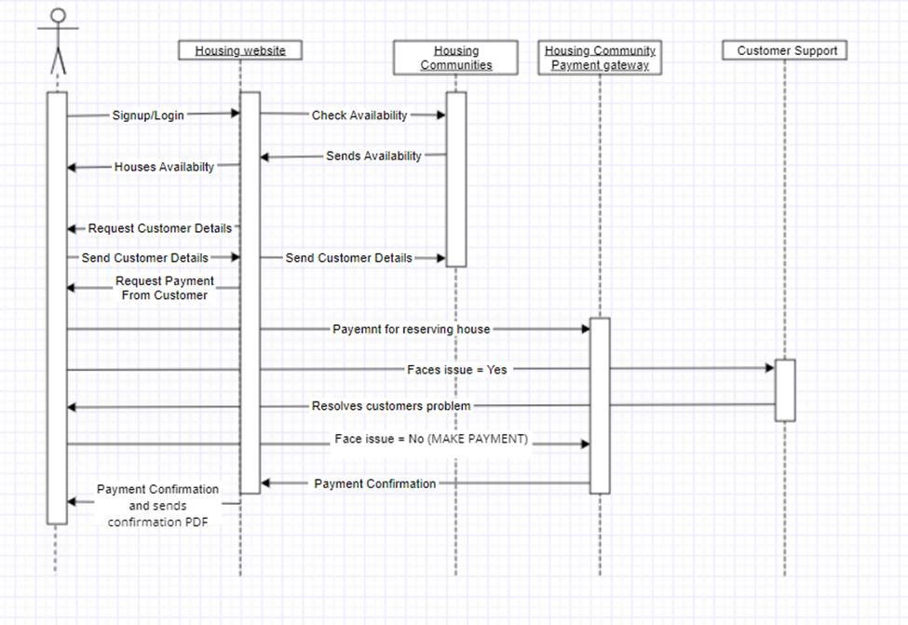
INTERFACE REQUIREMENTS

Slide 11
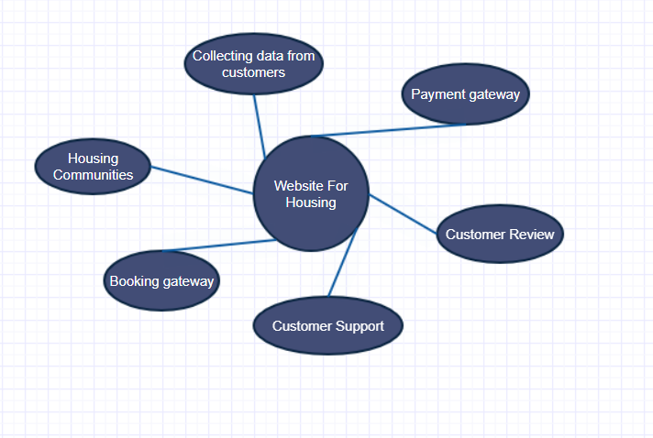
SYSTEM FEATURES

Slide 12
SYSTEM DESIGN
System Overview
•Customer selects the desired house using website
•Details of customer will be collected, and the customer will be redirected to payment gateway
•Once the initial payment is done, the housing property will be put on hold for 48 hours allowing the customer to finish the full and final payment.
•Once the payment is done, the property will be assigned to the customer
•A support helpdesk will be setup in order to assist the customers if they face any issue during the process
Notes:
The process starts with the customer selecting the desired house by using the filters in the website and when he picks the one, we collect his required information and redirect him to the payment gateway of the selected housing community for initial payment processing. Once the payment is processed, the housing community will send back the payment confirmation receipt to us which we will redirect to the customer and make sure that the selected property is on hold for 48 hours to finish the final payment for the processing.

Slide 13
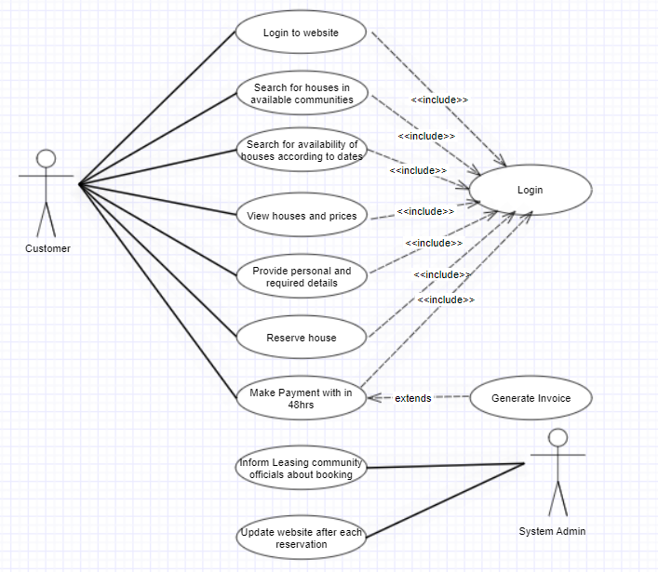
SYSTEM ARCHITECTURE
Notes:
Customer registers up in the website by giving details and searches for house of his choice from different communities, once the selection is done the customer is requested to provide personal details and the customer is redirected to housing community gateway in order to reserve the house by paying partial amount. Once the payment is done, the customer is given a timeframe of 48 hours within which the customer can complete the final payment. Once the final payment is done, the Leasing community will be informed about the booking and the website will be updated regarding the reservation.

Slide 14
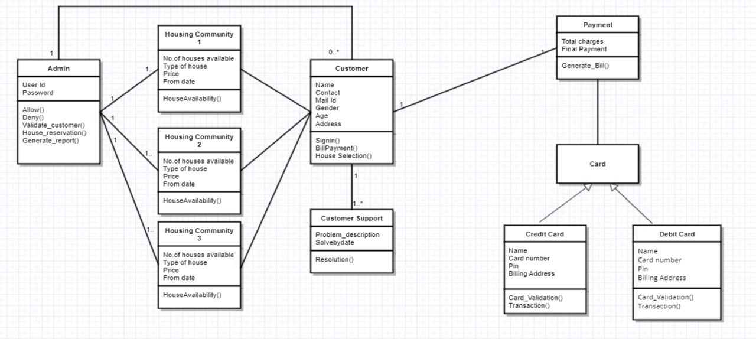
DATA AND COMPONENT DESIGN

Slide 15
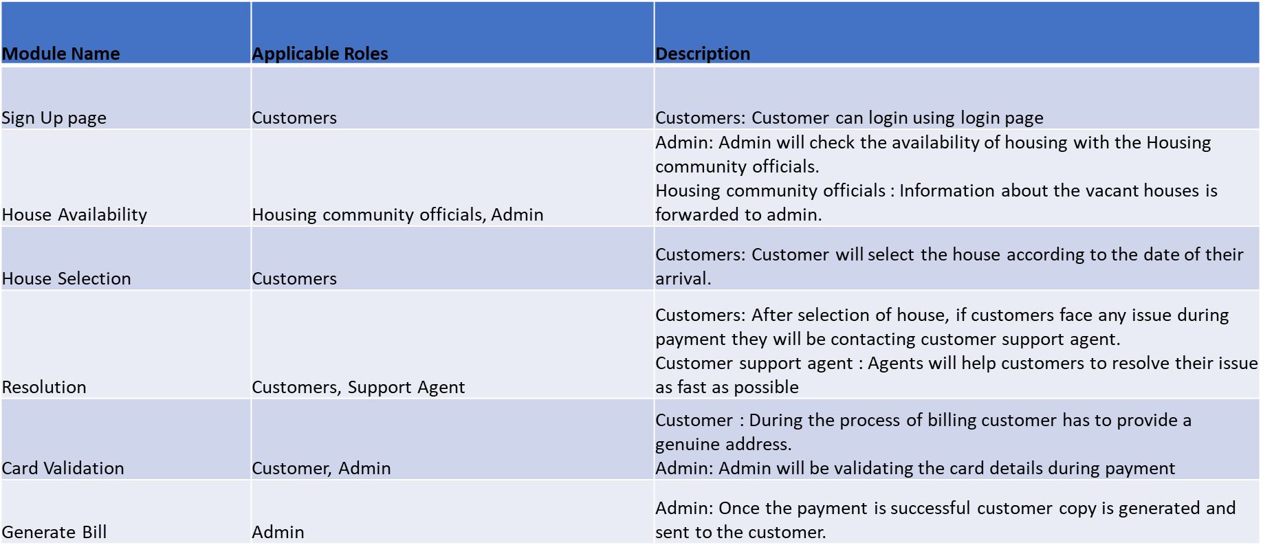
System Design
Requirement Matrix

Slide 16
Conclusions
One stop website for students to look up properties and rent them without the hassle of awaiting confirmation.
Eliminating the need to fill out multiple applications and realising that the listing is fake.

Slide 17
RECOMMENDATIONS & FURTHER ACTIONS
Multiple filters and choices to look out for housing communities according to specific needs.
Partnering with housing communities to enable customers for a specialised deals who book through our website.
Coming up with membership plans to provide high class customer care desk for better communication.

Slide 18
THANK YOU

